Slide 1
Design Principles
WKES2107: Human Computer Interaction
Dr Raja Jamilah Raja Yusof

Slide 2
Content
1.Don Normans Principles
2. Dieter Rams ten principles for good design
3. Shneiderman's "Eight Golden Rules of Interface Design“
4. Jakob Nielsen 10 Usability Heuristics for User Interface Design
5. Android Design Principles
6. iOS Design Principles
http://www.designprinciplesftw.com/

Slide 3
1.Don Normans Principles
Visibility
Feedback
Constraints
Mapping
Consistency
Affordance

Slide 4
Don Normans Principles of Design
Visibility
The more visible functions are, the more likely users will be able to know what to do next. In contrast, when functions are out of sight, it makes them more difficult to find and know how to use.
Feedback
Feedback is about sending back information about what action has been done and what has been accomplished, allowing the person to continue with the activity. Various kinds of feedback are available for interaction design-audio, tactile, verbal, and combinations of these.
Constraints
The design concept of constraining refers to determining ways of restricting the kind of user interaction that can take place at a given moment. There are various ways this can be achieved.

Slide 5
Don Normans Principles of Design
Mapping
This refers to the relationship between controls and their effects in the world. Nearly all artifacts need some kind of mapping between controls and effects, whether it is a flashlight, car, power plant, or cockpit. An example of a good mapping between control and effect is the up and down arrows used to represent the up and down movement of the cursor, respectively, on a computer keyboard.
Consistency
This refers to designing interfaces to have similar operations and use similar elements for achieving similar tasks. In particular, a consistent interface is one that follows rules, such as using the same operation to select all objects. For example, a consistent operation is using the same input action to highlight any graphical object at the interface, such as always clicking the left mouse button. Inconsistent interfaces, on the other hand, allow exceptions to a rule.
Affordance
A term used to refer to an attribute of an object that allows people to know how to use it. For example, a mouse button invites pushing (in so doing acting clicking) by the way it is physically constrained in its plastic shell. At a very simple level, to afford means to give a clue (Norman, 1988). When the affordances of a physical object are perceptually obvious it is easy to know how to interact with it.

Slide 6
2. Dieter Rams ten principles for good design
These design principles from the legendary product designer Dieter Rams has influenced not only the iconic product designs from Braun in the 1960s, but also the design of Apples products.
“My heart belongs to the details. I actually always found them to be more important than the big picture. Nothing works without details. They are everything, the baseline of quality” – Dieter Rams

Slide 7
Dieter Rams principles
Good design is innovative
Good design makes a product useful
Good design is aesthetic
Good design makes a product understandable
Good design is unobtrusive
Good design is honest
Good design is long-lasting
Good design is thorough down to the last detail
Good design is environmentally friendly
Good design is as little design as possible

Slide 8
Dieter Rams ten principles for good design
Good design is innovative
The possibilities for innovation are not, by any means, exhausted. Technological development is always offering new opportunities for innovative design. But innovative design always develops in tandem with innovative technology, and can never be an end in itself.
Good design makes a product useful
A product is bought to be used. It has to satisfy certain criteria, not only functional, but also psychological and aesthetic. Good design emphasises the usefulness of a product whilst disregarding anything that could possibly detract from it.
Good design is aesthetic
The aesthetic quality of a product is integral to its usefulness because products we use every day affect our person and our well-being. But only well-executed objects can be beautiful.
Good design makes a product understandable
It clarifies the products structure. Better still, it can make the product talk. At best, it is self-explanatory.
Good design is unobtrusive
Products fulfilling a purpose are like tools. They are neither decorative objects nor works of art. Their design should therefore be both neutral and restrained, to leave room for the users self-expression.

Slide 9
Dieter Rams ten principles for good design
Good design is honest
It does not make a product more innovative, powerful or valuable than it really is. It does not attempt to manipulate the consumer with promises that cannot be kept.
Good design is long-lasting
It avoids being fashionable and therefore never appears antiquated. Unlike fashionable design, it lasts many years - even in todays throwaway society.
Good design is thorough down to the last detail
Nothing must be arbitrary or left to chance. Care and accuracy in the design process show respect towards the consumer.
Good design is environmentally friendly
Design makes an important contribution to the preservation of the environment. It conserves resources and minimises physical and visual pollution throughout the lifecycle of the product.
Good design is as little design as possible
Less, but better - because it concentrates on the essential aspects, and the products are not burdened with non-essentials. Back to purity, back to simplicity.

Slide 10
3. Shneiderman's "Eight Golden Rules of Interface Design"
These Golden Rules of Interface Design are taken from the book, Designing the User Interface, which Ben Shneiderman co-authored. They were originally created in 1987 from the research Shneiderman done in Human Computer Interaction. They are applicable for most interactive systems.
These principles can help you create a well designed User Interface and thereby improve the usability of the system.

Slide 11
Shneiderman's principles
Strive for consistency
Enable frequent users to use shortcuts
Offer informative feedback.
Design dialog to yield closure.
Offer simple error handling.
Permit easy reversal of actions
Support internal locus of control.
Reduce short-term memory load.

Slide 12
Shneiderman's "Eight Golden Rules of Interface Design"
Strive for consistency
Consistent sequences of actions should be required in similar situations; identical terminology should be used in prompts, menus, and help screens; and consistent commands should be employed throughout.
Enable frequent users to use shortcuts
As the frequency of use increases, so do the user's desires to reduce the number of interactions and to increase the pace of interaction. Abbreviations, function keys, hidden commands, and macro facilities are very helpful to an expert user.
Offer informative feedback.
For every operator action, there should be some system feedback. For frequent and minor actions, the response can be modest, while for infrequent and major actions, the response should be more substantial.
Design dialog to yield closure.
Sequences of actions should be organized into groups with a beginning, middle, and end. The informative feedback at the completion of a group of actions gives the operators the satisfaction of accomplishment, a sense of relief, the signal to drop contingency plans and options from their minds, and an indication that the way is clear to prepare for the next group of actions.

Slide 13
Shneiderman's "Eight Golden Rules of Interface Design"
Offer simple error handling.
As much as possible, design the system so the user cannot make a serious error. If an error is made, the system should be able to detect the error and offer simple, comprehensible mechanisms for handling the error.
Permit easy reversal of actions
This feature relieves anxiety, since the user knows that errors can be undone; it thus encourages exploration of unfamiliar options. The units of reversibility may be a single action, a data entry, or a complete group of actions.
Support internal locus of control.
Experienced operators strongly desire the sense that they are in charge of the system and that the system responds to their actions. Design the system to make users the initiators of actions rather than the responders.
Reduce short-term memory load.
The limitation of human information processing in short-term memory requires that displays be kept simple, multiple page displays be consolidated, window-motion frequency be reduced, and sufficient training time be allotted for codes, mnemonics, and sequences of actions.

Slide 14
4. Jakob Nielsen 10 Usability Heuristics for User Interface Design
"The 10 most general principles for interaction design. They are called 'heuristics' because they are more in the nature of rules of thumb than specific usability guidelines."
These are one of the most used heuristics for User Interface Design. They were developed by Jakob Nielsen together with Rolf Molich in the early 90's. The final set, which you see here, was released by Nielsen in 1994.
The heuristics are explained in greater depth in this video on YouTube.

Slide 15
Jakob Nielsen Principles
Visibility of system status
Match between system and the real world
User control and freedom
Consistency and standards
Error prevention
Recognition rather than recall
Flexibility and efficiency of use
Aesthetic and minimalist design
Help users recognize, diagnose, and recover from errors
Help and documentation

Slide 16
Jakob Nielsen 10 Usability Heuristics
Visibility of system status
The system should always keep users informed about what is going on, through appropriate feedback within reasonable time.
Match between system and the real world
The system should speak the users' language, with words, phrases and concepts familiar to the user, rather than system-oriented terms. Follow real-world conventions, making information appear in a natural and logical order.
User control and freedom
Users often choose system functions by mistake and will need a clearly marked "emergency exit" to leave the unwanted state without having to go through an extended dialogue. Support undo and redo.
Consistency and standards
Users should not have to wonder whether different words, situations, or actions mean the same thing. Follow platform conventions.

Slide 17
Jakob Nielsen 10 Usability Heuristics
Error prevention
Even better than good error messages is a careful design which prevents a problem from occurring in the first place. Either eliminate error-prone conditions or check for them and present users with a confirmation option before they commit to the action.
Recognition rather than recall
Minimize the user's memory load by making objects, actions, and options visible. The user should not have to remember information from one part of the dialogue to another. Instructions for use of the system should be visible or easily retrievable whenever appropriate.
Flexibility and efficiency of use
Accelerators -- unseen by the novice user -- may often speed up the interaction for the expert user such that the system can cater to both inexperienced and experienced users. Allow users to tailor frequent actions.

Slide 18
Jakob Nielsen 10 Usability Heuristics
Aesthetic and minimalist design
Dialogues should not contain information which is irrelevant or rarely needed. Every extra unit of information in a dialogue competes with the relevant units of information and diminishes their relative visibility.
Help users recognize, diagnose, and recover from errors
Error messages should be expressed in plain language (no codes), precisely indicate the problem, and constructively suggest a solution.
Help and documentation
Even though it is better if the system can be used without documentation, it may be necessary to provide help and documentation. Any such information should be easy to search, focused on the user's task, list concrete steps to be carried out, and not be too large.

Slide 19
5.Android Design Principles
"These design principles were developed by and for the Android User Experience Team to keep users' best interests in mind. Consider them as you apply your own creativity and design thinking. Deviate with purpose."
Also check out this talk called, Enchant, Simplify, Amaze: Android's Design Principles from Google I/O 2013, where Rachel Gerb and Helena Roeber introduce these principles and explains them in greater detail.

Slide 20
Android principles
Delight me in surprising ways
Real objects are more fun than buttons and menus
Let me make it mine
Get to know me
Keep it brief
Pictures are faster than words
Decide for me but let me have the final say
Only show what I need when I need it
I should always know where I am
Never lose my stuff
If it looks the same, it should act the same
Only interrupt me if it's important
Give me tricks that work everywhere
It's not my fault
Sprinkle encouragement
Do the heavy lifting for me
Make important things fast

Slide 21
Android Design Principles
Delight me in surprising ways
A beautiful surface, a carefully-placed animation, or a well-timed sound effect is a joy to experience. Subtle effects contribute to a feeling of effortlessness and a sense that a powerful force is at hand.
Real objects are more fun than buttons and menus
Allow people to directly touch and manipulate objects in your app. It reduces the cognitive effort needed to perform a task while making it more emotionally satisfying.
Let me make it mine
People love to add personal touches because it helps them feel at home and in control. Provide sensible, beautiful defaults, but also consider fun, optional customizations that don't hinder primary tasks.
Get to know me
Learn peoples' preferences over time. Rather than asking them to make the same choices over and over, place previous choices within easy reach.
Keep it brief
Use short phrases with simple words. People are likely to skip sentences if they're long.

Slide 22
Android Design Principles
Pictures are faster than words
Consider using pictures to explain ideas. They get people's attention and can be much more efficient than words.
Decide for me but let me have the final say
Take your best guess and act rather than asking first. Too many choices and decisions make people unhappy. Just in case you get it wrong, allow for 'undo'.
Only show what I need when I need it
People get overwhelmed when they see too much at once. Break tasks and information into small, digestible chunks. Hide options that aren't essential at the moment, and teach people as they go.
I should always know where I am
Give people confidence that they know their way around. Make places in your app look distinct and use transitions to show relationships among screens. Provide feedback on tasks in progress.
Never lose my stuff
Save what people took time to create and let them access it from anywhere. Remember settings, personal touches, and creations across phones, tablets, and computers. It makes upgrading the easiest thing in the world.

Slide 23
Android Design Principles
If it looks the same, it should act the same
Help people discern functional differences by making them visually distinct rather than subtle. Avoid modes, which are places that look similar but act differently on the same input.
Only interrupt me if it's important
Like a good personal assistant, shield people from unimportant minutiae. People want to stay focused, and unless it's critical and time-sensitive, an interruption can be taxing and frustrating.
Give me tricks that work everywhere
People feel great when they figure things out for themselves. Make your app easier to learn by leveraging visual patterns and muscle memory from other Android apps. For example, the swipe gesture may be a good navigational shortcut.

Slide 24
Android Design Principles
It's not my fault
Be gentle in how you prompt people to make corrections. They want to feel smart when they use your app. If something goes wrong, give clear recovery instructions but spare them the technical details. If you can fix it behind the scenes, even better.
Sprinkle encouragement
Break complex tasks into smaller steps that can be easily accomplished. Give feedback on actions, even if it's just a subtle glow.
Do the heavy lifting for me
Make novices feel like experts by enabling them to do things they never thought they could. For example, shortcuts that combine multiple photo effects can make amateur photographs look amazing in only a few steps.
Make important things fast
Not all actions are equal. Decide what's most important in your app and make it easy to find and fast to use, like the shutter button in a camera, or the pause button in a music player.

Slide 25
6. iOS User Experience Guidelines
These are the Human Interface Guidelines for iOS, commonly referred to as the HIG. Please make sure to also check out the original source since it contains richer information with graphics showing examples of the principles applied as well as links to further resources.

Slide 26
iOS principles
Focus on the Primary Task
Elevate the Content that People Care About
Think Top Down
Give People a Logical Path to Follow
Make Usage Easy and Obvious
Use User-Centric Terminology
Minimize the Effort Required for User Input
Downplay File-Handling Operations
Enable Collaboration and Connectedness
De-emphasize Settings
Brand Appropriately
Make Search Quick and Rewarding
Entice and Inform with a Well-Written Description
Be Succinct
Use UI Elements Consistently
Consider Adding Physicality and Realism
Delight People with Stunning Graphics

Slide 27
Website for iOS principles
http://www.designprinciplesftw.com/collections/ios-user-experience-guidelines

Slide 28
Tutorial 6: Task 1
Read the Interaction Design book by Preece, Rogers and Sharp
Section to read on
Usability Goals
User Experience Goal
Get this book online at: https://www.safaribooksonline.com/ OR any other places
Choose 2 principles from
the 6 principles in this slide and
Facebook design principle
Ten Things we know to be true by Google
Design Principal for Windows store apps and
the other principles from http://www.designprinciplesftw.com/
Then, Map these principles to the appropriate Usability Goals and/ or as user experience goal (See table 1 and fill them up..)

Slide 29
Table 1
Principles | Effective To use | Efficient To use | Safe To Use | Have good Utility | Learnability | Memora- bility | User Experience Goal
Don Norman | Feedback | … | … | … | … | … | …
Android | … | … | … | … | … | … | Delight me in surprising ways
How to submit your report?
Combine these results in a table provided to you (in one of the PCs)
Comment on the result that you get. For example how many effective to use principle, how many efficient to use principles and ect.
Send in you work to Spectrum (don’t forget to write group member’s name)

Slide 30
Tutorial 6: Task 2
Find a website or a mobile app or a desktop interface of your own choice
Use one of the principles you have chosen
Relate those principles with the interface you have chosen in 1) with principles no 2
Show each principle relates to which interface structure
Write a brief report
Submit with the task no 1

Slide 31
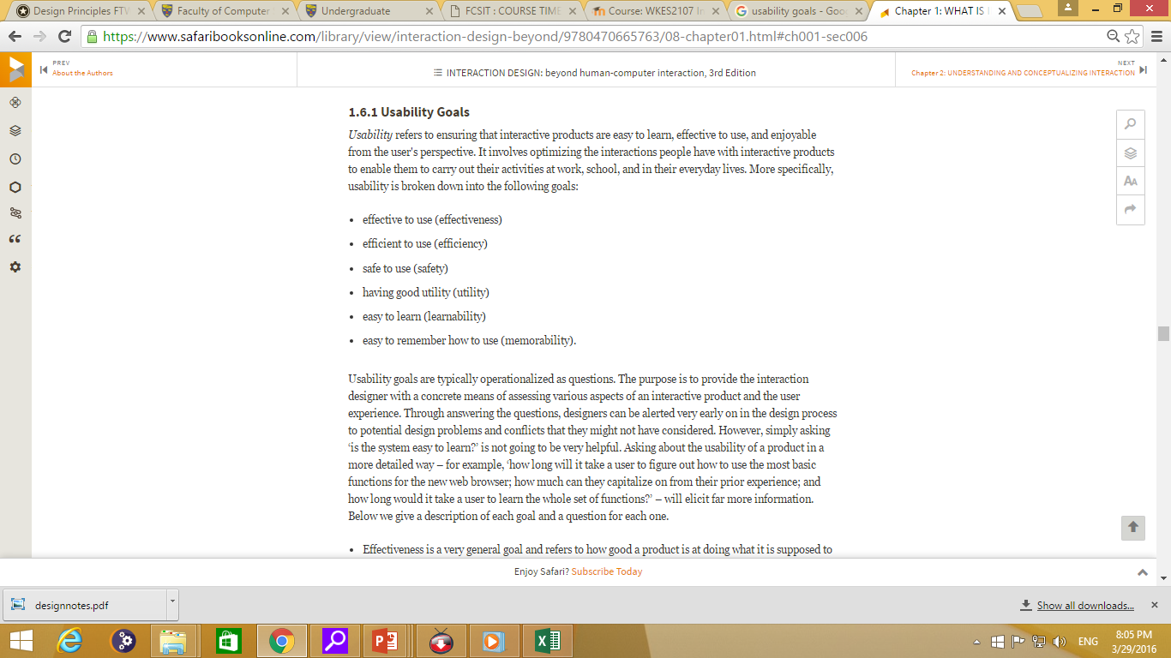

Slide 32
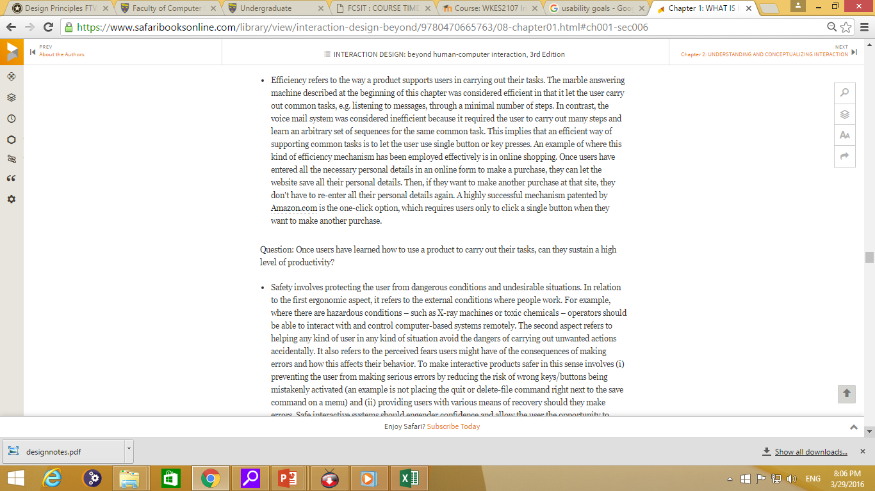

Slide 33
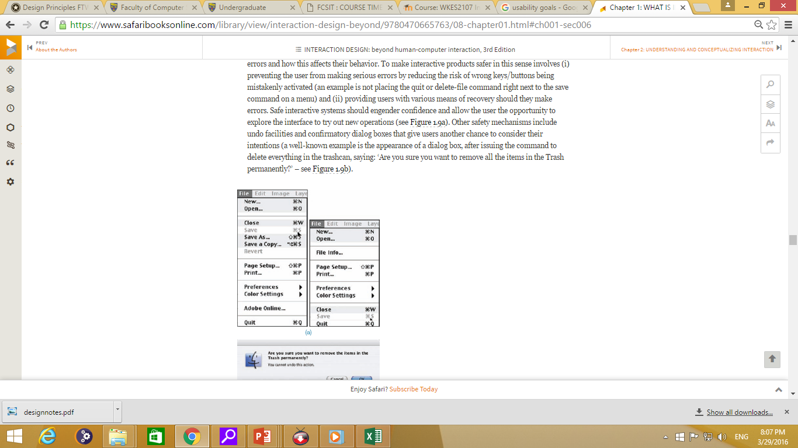

Slide 34
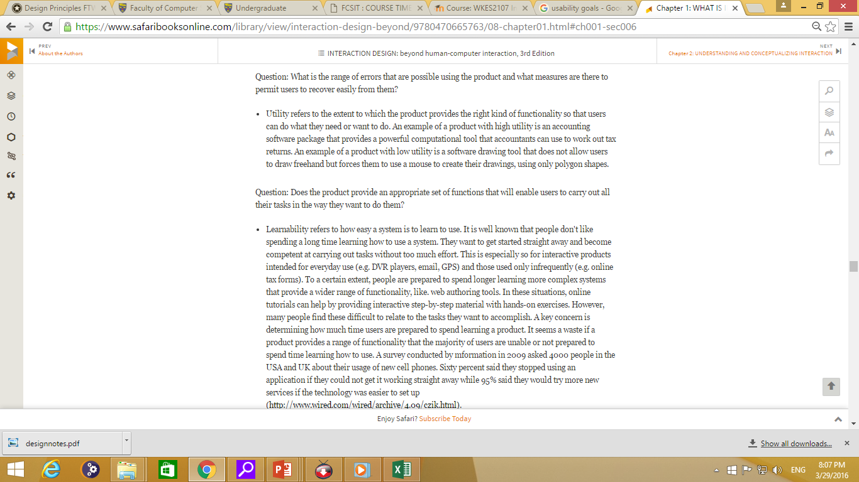

Slide 35
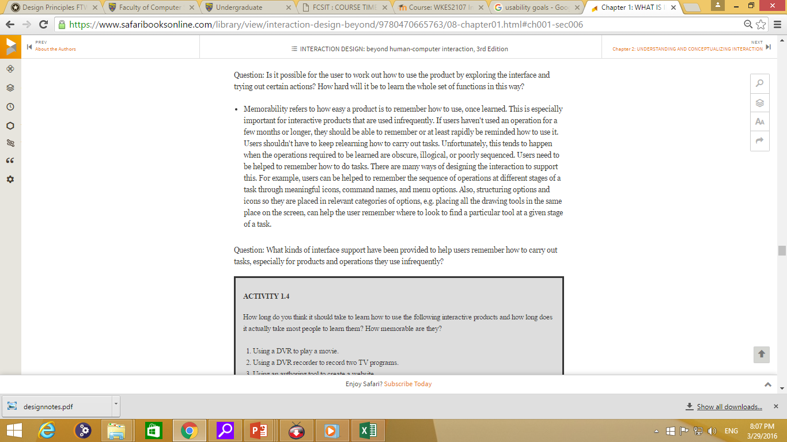

Slide 36
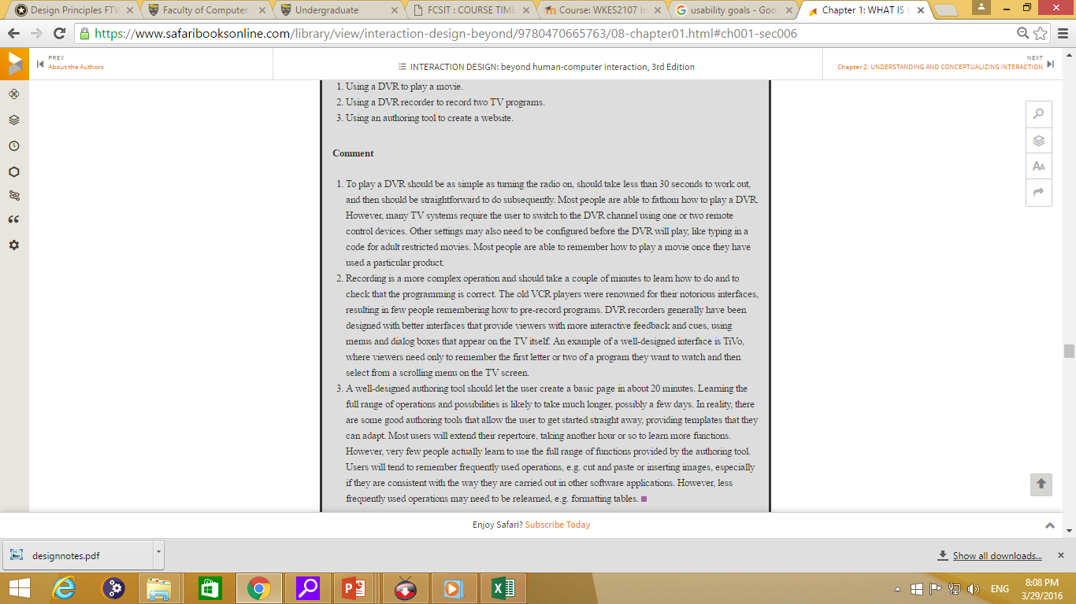

Slide 37
Interaction Design by Preece, Rogers, Sharp
https://www.safaribooksonline.com/

